Slide 1
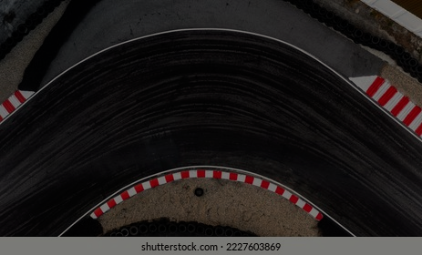


Predicting Podium Finishes Using Machine Learning (2007–2020)
University of Cincinnati – MS in Business Analytics Capstone
Student: Bala Manish Reddy Thumma
First Reader: Prof. Jeffrey Shaffer Second Reader: Prof. Timothy Lucas
F1™ logo used for educational purposes only. © Formula One Licensing BV

Slide 2
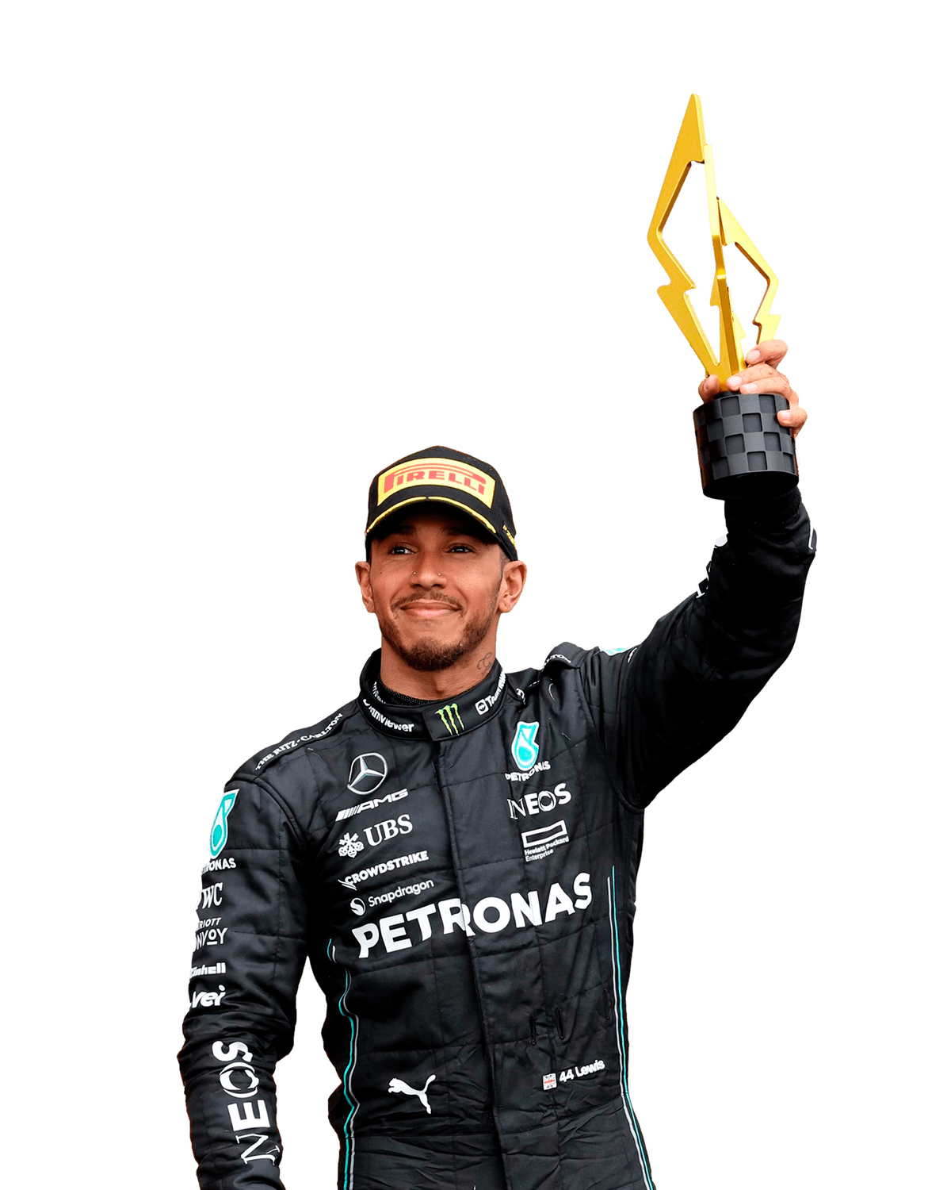
Introduction & Motivation
F1 is a data-rich sport with detailed race metrics.
Opportunity → use analytics to quantify performance drivers.
Aim → predict podium likelihood & explain key influences.
Podium = Top 3 finishers. 🏁

Slide 3
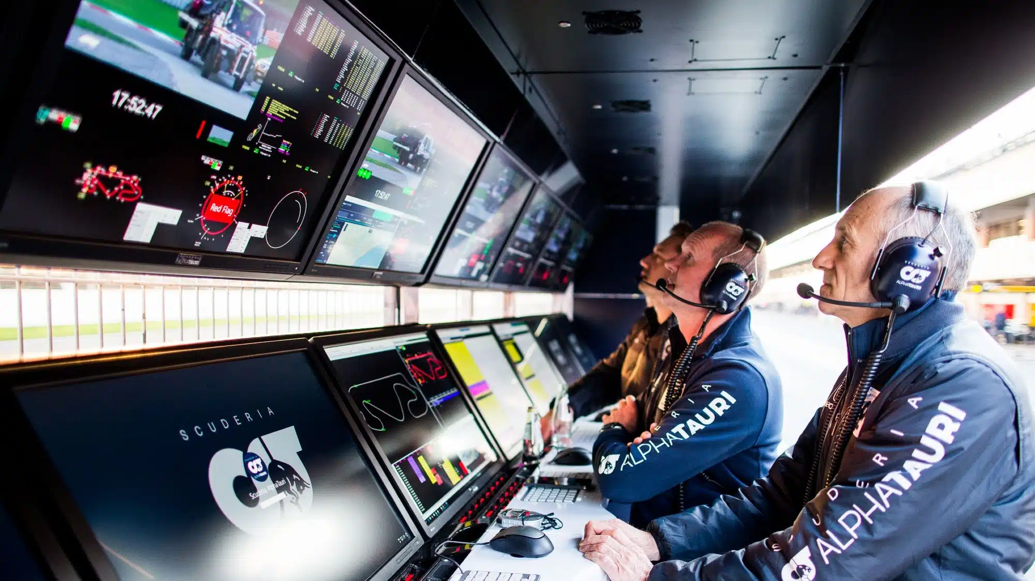
Problem Description
Dataset → Kaggle Formula 1 World Championship (1950–2020).
Focus → Modern era (2007–2020) for consistent data.
Binary target → Podium (1) vs Non-Podium (0).
Key challenges → Merge 13 tables + clean missing values.

Slide 4
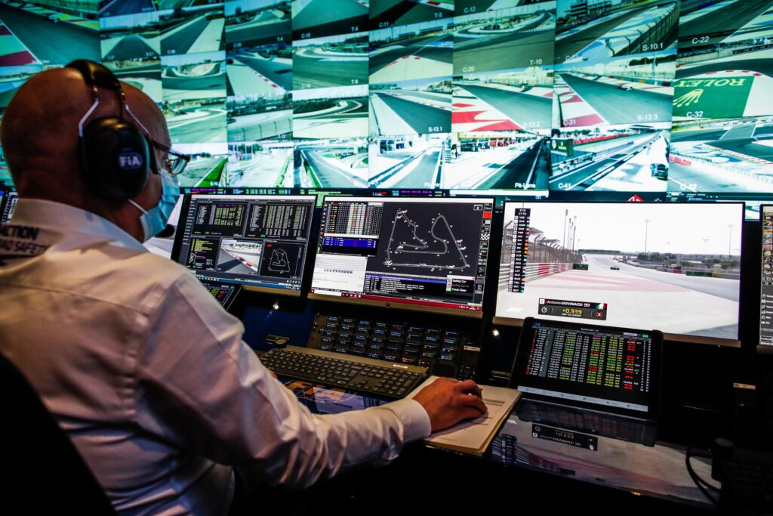
Data Preparation & Feature Engineering
Final dataset → 8231 rows × 7 key features.
Engineered variables:
Driver Experience → races completed to date.
Constructor Strength → average team performance per season.
Standardized features → grid, qualifying, laps, fastest-lap speed.

Slide 5
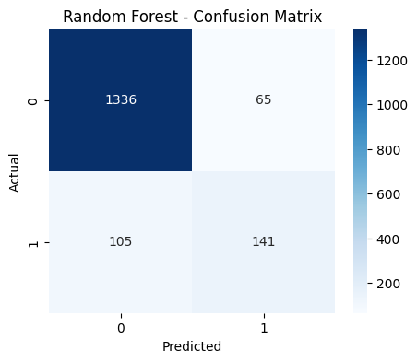
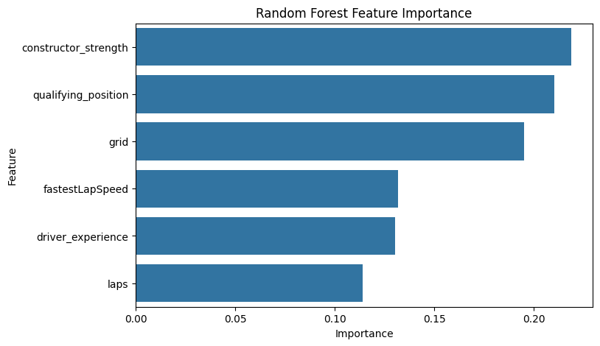
Modeling Approach
Algorithms tested → Logistic Regression & Random Forest.
Train/Test split → 70 / 30.
Metrics → Accuracy, AUC, MSPE.
Python libraries → pandas, scikit-learn.

Slide 6
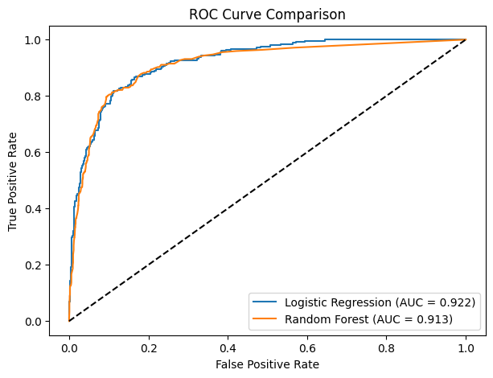
Model Comparison
Metric | Logistic Regression | Random Forest
Accuracy | 90.3 % | 89.7 %
AUC | 92.2 % | 91.3 %
MSPE | 0.0706 | 0.0734

Slide 7
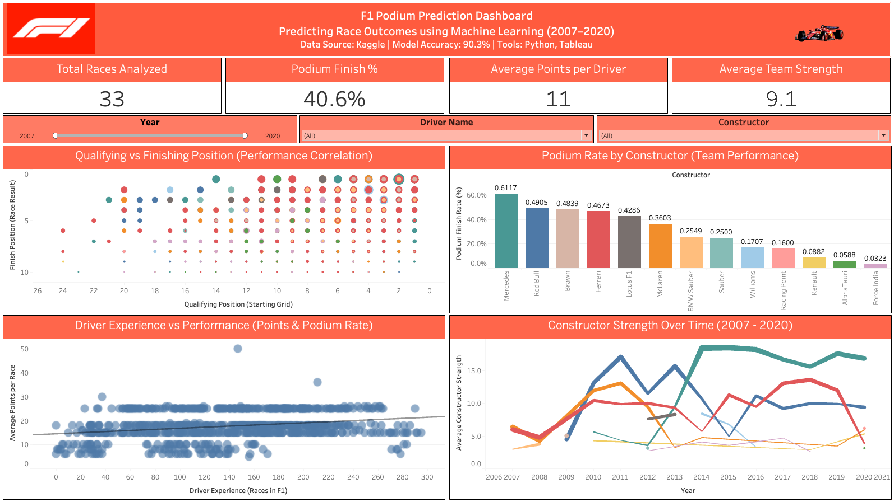
Tableau Dashboard Overview
Dashboard visualizes model features & insights.
KPIs (top): Total Races, Podium %, Avg Points, Team Strength.
Visuals:
Qualifying vs Finishing Position
Podium Rate by Constructor
Driver Experience vs Performance
Constructor Strength Over Time

Slide 8
Tableau Demo

Slide 9
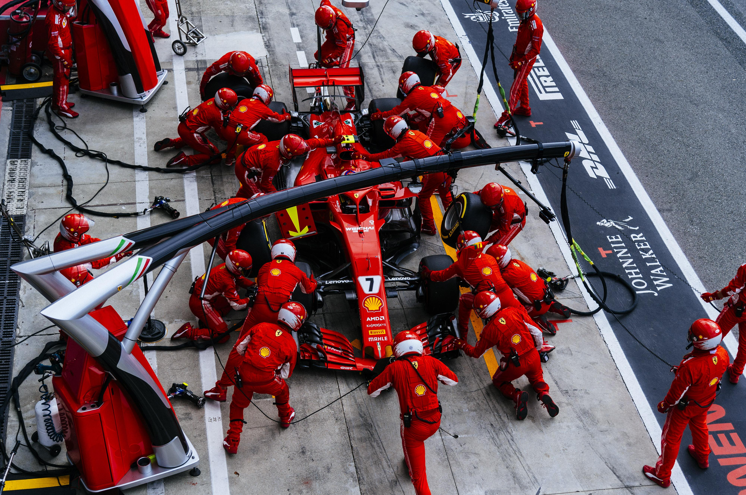
Conclusions & Future Work
Final model → Logistic Regression (AUC 0.92).
90 % accuracy with interpretable drivers.
Key predictors: Qualifying position, Grid, Constructor Strength, Experience.
Future Enhancements:
Add weather & track conditions.
Experiment with XGBoost / Gradient Boosting.
Deploy real-time race prediction dashboard.

Slide 10



References & Acknowledgments
Rohan Rao (2020). Formula 1 World Championship Dataset – Kaggle.
scikit-learn Documentation (2024)
Acknowledgment: Professors Shaffer & Lucas

